Slide 1
Employee Data Analysis using Excel
STUDENT NAME: Keerthana S
REGISTER NO:2213331042109
DEPARTMENT: Commerce
COLLEGE : Bharathi Women's College

Slide 2
PROJECT TITLE
Employee Performance Analysis using Excel

Slide 3


AGENDA
Problem Statement
Project Overview
End Users
Our Solution and Proposition
Dataset Description
Modelling Approach
Results and Discussion
Conclusion
3/21/2024 Annual Review

Slide 4

PROBLEM STATEMENT
Create an Excel-based system to track and analyse employee performance across key metrics, such as attendance, task completion, and quality of work, to identify trends, compare performance, and support data-driven decision-making in HR management.

Slide 5

PROJECT OVERVIEW
The project involves developing an Excel-based tool to monitor and evaluate employee performance using key metrics such as attendance, task completion, and quality of work. The tool will include data entry, automated performance calculations, and visual dashboards, enabling management to identify trends, compare employee performance, and make informed HR decisions efficiently.

Slide 6

WHO ARE THE END USERS?
The end users for this project are HR managers, team leads, and senior management, who will use the tool to monitor, evaluate, and report on employee performance.

Slide 7

OUR SOLUTION AND ITS VALUE PROPOSITION
### Solution: The solution is an Excel-based performance analysis tool that automates the tracking, evaluation, and visualization of employee performance data, making it easier for managers to assess productivity and identify areas for improvement. ### Value Proposition: This tool streamlines performance management, saving time on manual data analysis and providing actionable insights to enhance employee productivity and drive informed HR decisions, ultimately leading to better workforce management.

Slide 8
Dataset Description
The dataset includes employee details such as Name, Employee ID, and Department, along with performance metrics like attendance, task completion rates, quality of work, and efficiency. This data is collected periodically (e.g., weekly, monthly) and used to assess and compare individual and team performance.

Slide 9

THE "WOW" IN OUR SOLUTION
The solution is a streamlined Excel tool that automates the tracking and analysis of employee performance metrics, providing clear visual insights to help managers efficiently monitor, assess, and improve workforce productivity.
3/21/2024 Annual Review
9

Slide 10
MODELLING
The modelling involves setting up formulas and functions in Excel to calculate performance scores based on key metrics like attendance and task completion. These calculations feed into dynamic dashboards that visualize trends and comparisons, allowing for easy analysis and decision-making.
10

Slide 11
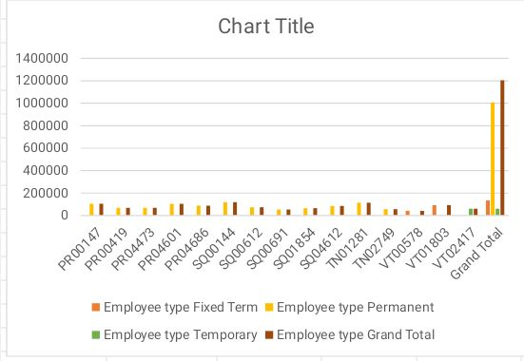
RESULTS
11

Slide 12
conclusion
In conclusion, this Excel-based performance analysis tool offers a powerful yet simple solution for monitoring and improving employee productivity. By providing automated insights and clear visualizations, it enables better decision-making and enhances overall workforce management.

